Slide 1
Research Updates:
Objective 1
Effectiveness of Chlorine Against Tulane Virus, A Human Norovirus Surrogate, and Escherichia coli in Preharvest Agricultural Water
Notes:
Introduce the research focus: evaluating chlorine’s effectiveness on microbial contaminants in agricultural water.
Mention the pathogens tested: Tulane virus (a norovirus surrogate) and E. coli.
Explain the broader goal: improving preharvest water safety to support food safety standards.

Slide 2
Research Highlights
Chlorine is an effective sanitizer against both bacteria and viruses in agricultural water.
Higher-than-recommended chlorine concentrations were required for optimal virus inactivation.
Water sources significantly influenced the antimicrobial efficacy of chlorine.
Achieving a 3-log₁₀ reduction in norovirus with high chlorine concentrations may not be practical.
Notes:
Highlight chlorine’s general efficacy against bacteria and viruses.
Note that viruses, particularly Tulane virus, require higher chlorine concentrations than typically recommended.
Emphasize how water source composition significantly affects chlorine’s effectiveness.
Conclude with the practical implication: achieving full virus inactivation (3-log₁₀) may not be feasible under standard field conditions.

Slide 3
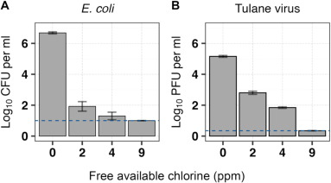
Microbial Inactivation in Control Groups (Phosphate Buffer Dilution Water)
In control groups, Tulane virus showed a rapid reduction of 3.55 ± 0.25 log₁₀ PFU in 5 min at 4 ppm, leading to viral titers of 1.66 ± 0.19 log₁₀ PFU/ml.
In contrast, E. coli in PBDW showed an immediate 4.74 ± 0.26 log₁₀ CFU reduction within 5 min at 2 ppm free chlorine, reaching 1.93 ± 0.22 log₁₀ CFU/ml.
Notes:
Discuss the controlled conditions using phosphate buffer dilution water.
Tulane virus showed substantial inactivation (3.55 log₁₀ PFU) within 5 minutes at 4 ppm.
E. coli showed even greater sensitivity with a 4.74 log₁₀ CFU drop at only 2 ppm.
Use this to establish a baseline of chlorine’s potential under ideal conditions.

Slide 4
Microbial Inactivation in Control Groups (Phosphate Buffer Dilution Water)
A 5-min treatment with 9 ppm free chlorine inactivated Tulane virus and E. coli to nondetectable levels, corresponding to concentrations of less than 0.347 log₁₀ PFU/ml and
1.0 log₁₀ CFU/ml, respectively.
Notes:
A higher concentration of chlorine (9 ppm) led to complete inactivation (non-detectable levels) of both organisms.
Reinforce the dose-response relationship.
Point out this indicates potential success in optimal conditions but does not necessarily reflect real-world water sources.

Slide 5
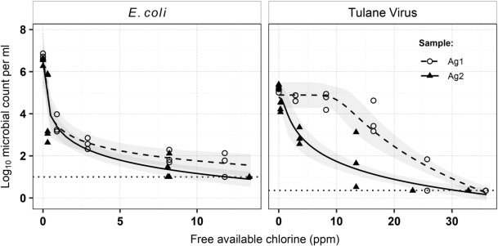
Inactivation of E. coli and Tulane Virus in Agricultural Water Samples Following a 5-min Treatment with Calcium Hypochlorite
The chlorine demand for agricultural water samples was higher than that of controls.
Except for the Tulane virus in the Ag1 sample, all other conditions resulted in rapid initial microbial inactivation.
Notes:
Shift to real-world water sources (agricultural water).
These samples had higher chlorine demand due to organic/inorganic matter.
Most samples showed rapid microbial reduction except for Tulane virus in one sample (Ag1), suggesting matrix interference.

Slide 6
Inactivation of E. coli and Tulane Virus in Agricultural Water Samples Following a 5-min Treatment with Calcium Hypochlorite
The log₁₀-logistic model predicted that achieving the EPA/FDA 3-log₁₀ microbial reduction criteria in the agricultural water samples required treatment with free chlorine ranging between 0.6 and 0.9 ppm for E. coli and 9.6–23 ppm for Tulane virus.
Notes:
Present the model used to predict necessary chlorine levels for regulatory compliance.
Highlight the large difference in required concentrations: 0.6–0.9 ppm for E. coli, but up to 23 ppm for Tulane virus.
Stress the challenge of reaching viral inactivation targets in typical field settings.

Slide 7


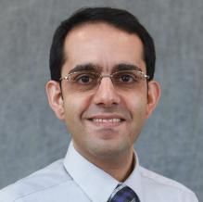

More Information
Check out our paper!
Ashlyn Lake
Research Assistant
University of Florida
ashlynlake@ufl.edu
Naim Montazeri
Assistant Professor of Food and Environmental Virology
University of Florida
nmontazeri@ufl.edu
This work is supported by the Specialty Crops Research Initiative [grant no. 2020-51181-32157] from the USDA National Institute of Food and Agriculture. Any opinions, findings, conclusions, or recommendations expressed in this presentation are those of the speakers and do not necessarily reflect the view of the U.S. Department of Agriculture.
Notes:
Acknowledge funding from the USDA Specialty Crops Research Initiative.
Mention that the findings represent the views of the researchers, not necessarily the USDA.
Direct interested parties to the paper and provide researcher contact information for further questions or collaborations.

